Slide 1


Data Science for Cybersecurity
26
PART V · DATA SCIENCE IN SYSTEMS CONTEXT
CHAPTER 26 · WEEK 15
Data Science — From Foundations to Intelligent Systems
LECTURER
Dr. Mustafa Hameed
THE ISLAMIA UNIVERSITY OF BAHAWALPUR
Bahawalpur, Pakistan
Department of Information Technology · BSIT · Fall 2026
Notes:
Chapter 26: Data Science for Cybersecurity. Part 5 — Data Science in Systems Context. Week 15: Data science for IoT and cybersecurity. Handout pages 168–174.

Slide 2

Where this chapter sits
THE COURSE
PART I
PART II
PART III
PART IV
PART V
PART VI
1
2
3
4
5
6
7
8
9
10
11
12
13
14
15
16
17
18
19
20
21
22
23
24
25
26
27
28
29
30
31
32
Data Science for Cybersecurity
BUILDS ON
USED LATER IN
Ch 6 Probability and Uncertainty
— the course ends here
Ch 14 Model Evaluation and Selection
Ch 16 Unsupervised Learning and Anomaly Detection
Ch 19 Sequences, Time Series and Streaming Analytics
Data Science · Chapter 26 · Data Science for Cybersecurity
Handout p. 168 2
Notes:
Place the chapter. Before you start: Chapter 6 (base rates — the arithmetic that governs every alerting decision), Chapter 14 (imbalance, PR curves, cost-based thresholds), Chapter 16 (anomaly detection) and Chapter 19 (streaming and drift).

Slide 3

What you will be able to do
LEARNING OUTCOMES
By the end of this chapter you will be able to:
1
Identify the principal security data sources and what each can and cannot reveal.
2
Design detection for intrusion, malware, phishing and insider misuse, choosing supervised or unsupervised methods appropriately.
3
Quantify the alert-fatigue problem and set thresholds that a real SOC can sustain.
4
Explain the four classes of attack against machine learning systems themselves.
5
Specify defences for a deployed security model against an adaptive adversary.
Data Science · Chapter 26 · Data Science for Cybersecurity
Handout p. 168 3
Notes:
Read these out: they are the chapter's contract with the room. Each click adds one.

Slide 4

Vocabulary for this chapter
KEY TERMS
SIEM
NetFlow
intrusion detection
signature vs anomaly detection
UEBA
baseline
alert fatigue
threat intelligence
adversarial machine learning
evasion
poisoning
model extraction
membership inference
defence in depth
Each term is defined where it first matters — not here.
Data Science · Chapter 26 · Data Science for Cybersecurity
Handout p. 168 4
Notes:
Do not define these now; they arrive one at a time. This slide is for the students' notes. Terms: SIEM; NetFlow; intrusion detection; signature vs anomaly detection; UEBA; baseline; alert fatigue; threat intelligence; adversarial machine learning; evasion; poisoning; model extraction; membership inference; defence in depth.

Slide 5

In this chapter
IN THIS CHAPTER
26.1
What Makes This Domain Different
p. 168 ›
26.2
Security Data Sources
p. 168 ›
26.3
The Alert Fatigue Problem
p. 169 ›
26.4
Four Detection Problems
p. 170 ›
26.5
Attacking the Model Itself
p. 171 ›
Data Science · Chapter 26 · Data Science for Cybersecurity
Handout pp. 168–174 5
Notes:
The route through the chapter. Each row is a link: click it to jump to that section in the slide show.

Slide 6

The Assumption That Fails Here
WATCH OUT
Every method in Part III assumes the data is generated by a process that does not care what your model does. In security that assumption is false. There is a human adversary who will observe your defence, work out its boundary and step around it. This changes the discipline: a security model is not fitted once and monitored — it is contested continuously. Nothing else in this book faces that.
Data Science · Chapter 26 · Data Science for Cybersecurity
§26.1 · Handout p. 168 6
Notes:
Read the box aloud, then ask for an example from the room before moving on.

Slide 7
Security Data Sources
SECTION 2 OF 5
26.2
26.1 What Makes This Domain Different
26.2 Security Data Sources
26.3 The Alert Fatigue Problem
26.4 Four Detection Problems
26.5 Attacking the Model Itself
Data Science · Chapter 26
Handout §26.2 7
Notes:
Pause. Name the question this section answers.

Slide 8

Security Data Sources
AT A GLANCE
Source | Contains | Blind spot you must know about
Authentication logs | Who logged in, from where, success or failure | Says nothing about what they did afterwards
NetFlow / traffic metadata | Who talked to whom, how much, for how long | No payload; encrypted traffic looks identical to benign
Endpoint (EDR) | Processes, files, registry, command lines | Only on hosts with an agent installed — rarely all of them
DNS logs | Every name resolved | Very high volume; heavy encoding of exfiltration
Firewall / proxy | Allowed and blocked connections | Only what traverses the boundary; lateral movement is invisible
Application logs | Business-level actions | Format varies per app; often the first thing an attacker disables
Threat intelligence | Known-bad indicators | Only covers what someone has already seen and published
Data Science · Chapter 26 · Data Science for Cybersecurity
§26.2 · Handout p. 168 8
Notes:
Do not read the table row by row: pick the row the room is most likely to get wrong and ask why.

Slide 9

Signature versus Anomaly Detection
CONCEPT
Signature detection matches known-bad patterns: precise, fast, explainable, and structurally incapable of catching anything new. Anomaly detection flags deviation from normal: can catch novel attacks, and generates far more false positives. Real systems run both — signatures handle the known volume cheaply so that analysts’ attention is available for the anomalies.
Data Science · Chapter 26 · Data Science for Cybersecurity
§26.2 · Handout p. 168 9
Notes:
Read the box aloud, then ask for an example from the room before moving on.

Slide 10
The Alert Fatigue Problem
SECTION 3 OF 5
26.3
26.1 What Makes This Domain Different
26.2 Security Data Sources
26.3 The Alert Fatigue Problem
26.4 Four Detection Problems
26.5 Attacking the Model Itself
Data Science · Chapter 26
Handout §26.3 10
Notes:
Pause. Name the question this section answers.

Slide 11

Sizing a SOC’s Alert Budget
WORKED EXAMPLE
An organisation processes 2 million authentication events daily. Roughly 20 are genuinely malicious (10⁻⁵ base rate). Three analysts each investigate about 40 alerts a day, so the sustainable budget is 120 alerts/day.
Detector A — 95% recall, 0.1% false-positive rate.
• True positives: 20 × 0.95 = 19
• False positives: 1,999,980 × 0.001 = 2,000
• Alerts/day: 2,019 — 17× over budget
• Precision: 19/2019 = 0.9%
Unworkable. Within two weeks analysts triage by gut feel and the tool is effectively off.
Detector B — 70% recall, 0.005% false-positive rate.
Data Science · Chapter 26 · Data Science for Cybersecurity
§26.3 · Handout p. 169 11
Notes:
Each click adds one step of the working. Ask for the next number before you reveal it.

Slide 12
Sizing a SOC’s Alert Budget (continued)
WORKED EXAMPLE
• True positives: 14
• False positives: 1,999,986 × 0.00005 = 100
• Alerts/day: 114 — within budget
• Precision: 14/114 = 12.3%
B is the better detector despite catching five fewer real attacks in theory, because A’s alerts will not actually be investigated. The realistic comparison is 14 attacks investigated versus perhaps 3 — whichever of A’s 2,019 alerts happen to get looked at.
The design rule: start from the analyst capacity and work backwards to the required false-positive rate. Here, 120 alerts/day against 2 million events demands an FPR below 6×10⁻⁵. Any model that cannot reach that is not deployable at this volume, however good its ROC-AUC — which, note, would be excellent for both detectors.
Data Science · Chapter 26 · Data Science for Cybersecurity
§26.3 · Handout p. 169 12
Notes:
Each click adds one step of the working. Ask for the next number before you reveal it.

Slide 13
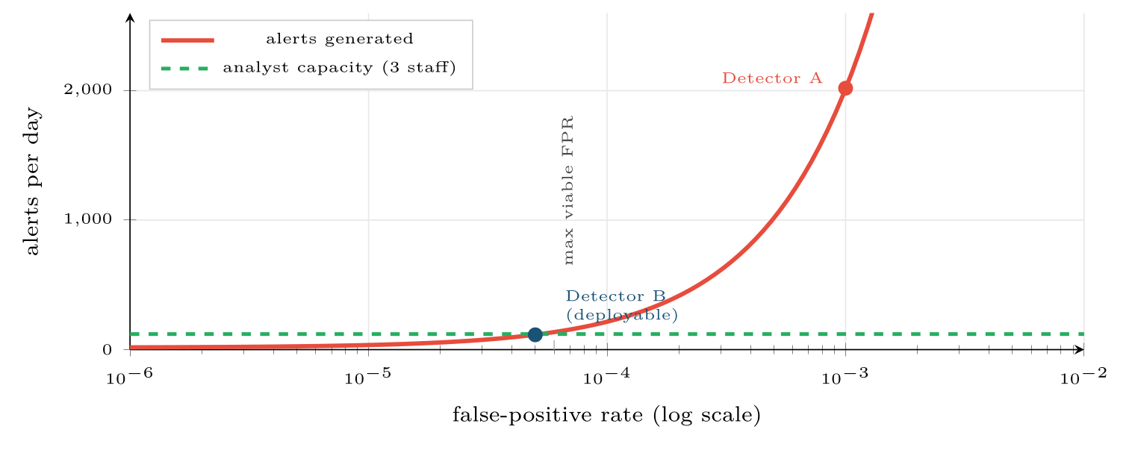
Alert volume against false-positive rate at 2 million events per day
FIGURE 26.1
The relationship is linear and brutal: the analyst capacity line fixes a maximum FPR, and that constraint — not accuracy — determines whether a detector can be deployed.
Data Science · Chapter 26 · Data Science for Cybersecurity
§26.3 · Handout p. 169 13
Notes:
Figure 26.1 (handout p. 170): Alert volume against false-positive rate at 2 million events per day. The relationship is linear and brutal: the analyst capacity line fixes a maximum FPR, and that constraint — not accuracy — determines whether a detector can be deployed.

Slide 14
Four Detection Problems
SECTION 4 OF 5
26.4
26.1 What Makes This Domain Different
26.2 Security Data Sources
26.3 The Alert Fatigue Problem
26.4 Four Detection Problems
26.5 Attacking the Model Itself
Data Science · Chapter 26
Handout §26.4 14
Notes:
Pause. Name the question this section answers.

Slide 15
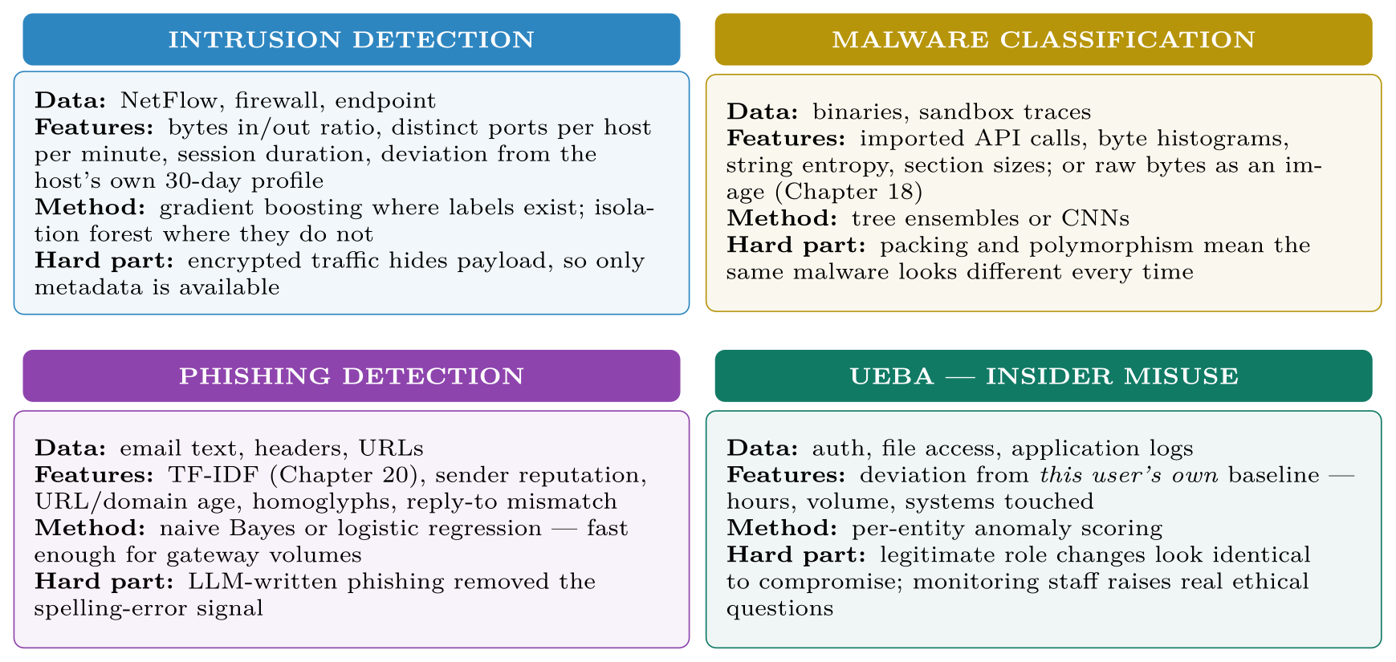
Four Detection Problems
FIGURE 26.2
Four detection problems, their data, their standard methods and the difficulty that defines each. Note that three of the four rely on per-entity baselines rather than global thresholds.
Data Science · Chapter 26 · Data Science for Cybersecurity
§26.4 · Handout p. 170 15
Notes:
Figure 26.2 (handout p. 170): Four detection problems, their data, their standard methods and the difficulty that defines each. Note that three of the four rely on per-entity baselines rather than global thresholds.

Slide 16
The Single Most Useful Feature Idea in Security Analytics
CONCEPT
Compare an entity against its own history, not against the population. A server that suddenly contacts 200 external addresses is alarming even if 200 is unremarkable for other servers; a user working at 3 a.m. matters only if that user never has. Per-entity baselines convert an intractable global-threshold problem into a tractable per-entity one, and they are what makes UEBA work.
Data Science · Chapter 26 · Data Science for Cybersecurity
§26.4 · Handout p. 170 16
Notes:
Read the box aloud, then ask for an example from the room before moving on.

Slide 17
Attacking the Model Itself
SECTION 5 OF 5
26.5
26.1 What Makes This Domain Different
26.2 Security Data Sources
26.3 The Alert Fatigue Problem
26.4 Four Detection Problems
26.5 Attacking the Model Itself
Data Science · Chapter 26
Handout §26.5 17
Notes:
Pause. Name the question this section answers.

Slide 18

Adversarial Machine Learning
DEFINITION
Attacks that target the ML system rather than the network around it. Four classes, distinguished by when they act and what they want.
Data Science · Chapter 26 · Data Science for Cybersecurity
§26.5 · Handout p. 171 18
Notes:
Read the box aloud, then ask for an example from the room before moving on.

Slide 19
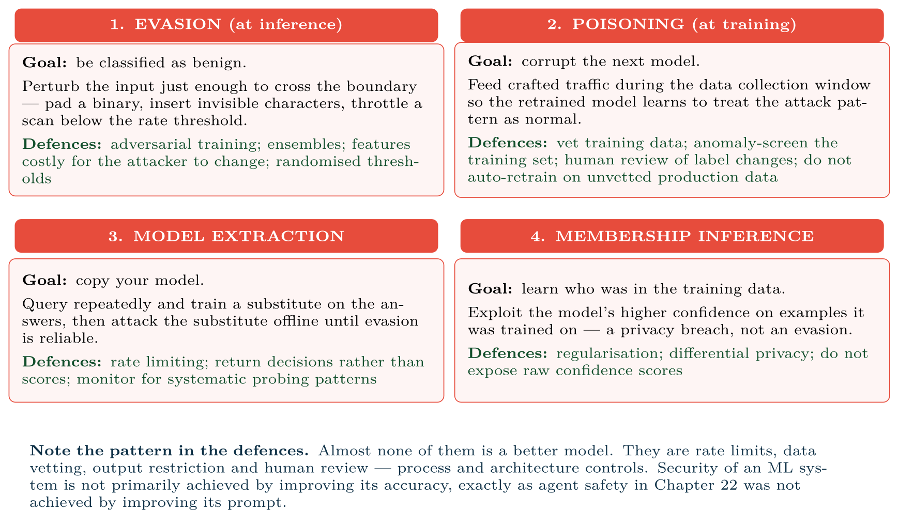
The four classes of attack on machine learning systems
FIGURE 26.3
Evasion and extraction happen at inference time; poisoning happens at training time; membership inference targets privacy rather than performance.
Data Science · Chapter 26 · Data Science for Cybersecurity
§26.5 · Handout p. 171 19
Notes:
Figure 26.3 (handout p. 171): The four classes of attack on machine learning systems. Evasion and extraction happen at inference time; poisoning happens at training time; membership inference targets privacy rather than performance.

Slide 20
Retraining on Production Data Is an Attack Surface
WATCH OUT
The advice from Chapter 27 — retrain regularly on recent data to counter drift — is exactly the mechanism a poisoning attack exploits. In security you cannot have both automatic retraining and unvetted training data. Either screen the training set for anomalies before use, or keep a human in the approval path for model promotion. This is a genuine tension between two pieces of good advice, and the resolution is domain-specific.
Data Science · Chapter 26 · Data Science for Cybersecurity
§26.5 · Handout p. 171 20
Notes:
Read the box aloud, then ask for an example from the room before moving on.

Slide 21
A Concrete Evasion, and Why Feature Choice Is a Defence
WORKED EXAMPLE
A detector flags port scans using distinct_ports_per_minute > 50.
The evasion: the attacker scans 40 ports per minute instead. Detection drops to zero; the scan takes 25% longer, which costs the attacker almost nothing.
Why the model was fragile: the feature is cheap for the attacker to control. Any threshold on a directly-controllable quantity is one experiment away from being defeated.
A more robust feature set:
• distinct_ports_per_hour — a longer window; slowing further costs real time.
• fraction_of_ports_that_are_closed — a scanner necessarily hits closed ports; legitimate traffic rarely does. Hard to avoid without already knowing the answer.
• deviation from this source's own 30-day profile — a host that has never initiated outbound connections doing so at all is anomalous at any rate.
Data Science · Chapter 26 · Data Science for Cybersecurity
§26.5 · Handout p. 171 21
Notes:
Each click adds one step of the working. Ask for the next number before you reveal it.

Slide 22
A Concrete Evasion, and Why Feature Choice Is a Defence (continued)
WORKED EXAMPLE
• sequential-port-ordering score — avoidable, but only by randomising, which is itself detectable.
The principle: prefer features that are expensive or self-defeating for the attacker to manipulate. In ordinary machine learning you choose features for predictive power; in security you choose them for predictive power and manipulation cost. That is a genuinely different design criterion, and it is the main thing this chapter adds to Chapter 15.
Data Science · Chapter 26 · Data Science for Cybersecurity
§26.5 · Handout p. 171 22
Notes:
Each click adds one step of the working. Ask for the next number before you reveal it.

Slide 23





Four lenses: Security Analytics
FOUR LENSES
LEARNING ANALYTICS
PROJECT MANAGEMENT
Academic integrity analytics is structurally the same problem and inherits the same arithmetic.
Security work has a distinctive project profile: success is invisible, and the business case rests on losses that did not happen.
INTERNET OF THINGS
CYBERSECURITY
The two chapters meet directly.
This chapter is the security lens in full.
Data Science · Chapter 26 · Data Science for Cybersecurity
Handout p. 174 23
Notes:
The same method, four domains. Each of the next four slides opens one lens in full.

Slide 24

Learning Analytics: Security Analytics
FOUR LENSES
LEARNING ANALYTICS
Project Management
Academic integrity analytics is structurally the same problem and inherits the same arithmetic. Cheating is rare, so the base rate is low and precision will be poor — a plagiarism or exam-proctoring flag is evidence to investigate, never a verdict. Students also adapt: publicise a detection rule and behaviour changes to evade it, which is the adversarial dynamic in a setting where the “adversary” is someone you owe a duty of care. The ethical stakes here are higher than in a SOC, and Chapter 28 should be read alongside this.
Internet of Things
Cybersecurity
Data Science · Chapter 26 · Data Science for Cybersecurity
Handout p. 174 24
Notes:
Learning Analytics. Academic integrity analytics is structurally the same problem and inherits the same arithmetic. Cheating is rare, so the base rate is low and precision will be poor — a plagiarism or exam-proctoring flag is evidence to investigate, never a verdict. Students also adapt: publicise a detection rule and behaviour changes to evade it, which is the adversarial dynamic in a setting where the “adversary” is someone you owe a duty of care. The ethical stakes here are higher than in a SOC, and Chapter 28 should be read alongside this.

Slide 25

Project Management: Security Analytics
FOUR LENSES
PROJECT MANAGEMENT
Learning Analytics
Security work has a distinctive project profile: success is invisible, and the business case rests on losses that did not happen. Metrics that survive contact with management are mean time to detect, mean time to respond, coverage of assets monitored, and alerts per analyst — not model accuracy. Budget for the fact that detection engineering is continuous maintenance rather than a delivery with an end date; a model shipped and left alone degrades faster here than anywhere else in this book.
Internet of Things
Cybersecurity
Data Science · Chapter 26 · Data Science for Cybersecurity
Handout p. 174 25
Notes:
Project Management. Security work has a distinctive project profile: success is invisible, and the business case rests on losses that did not happen. Metrics that survive contact with management are mean time to detect, mean time to respond, coverage of assets monitored, and alerts per analyst — not model accuracy. Budget for the fact that detection engineering is continuous maintenance rather than a delivery with an end date; a model shipped and left alone degrades faster here than anywhere else in this book.

Slide 26

Internet of Things: Security Analytics
FOUR LENSES
INTERNET OF THINGS
Learning Analytics
The two chapters meet directly. IoT fleets are a favoured target — weak credentials, unpatched firmware, plaintext protocols — and a compromised device is often first visible as anomalous telemetry, meaning the maintenance detector of Chapter 25 is also a security sensor. Conversely, telemetry can be forged, so readings from a device are not trustworthy evidence about that device. Cross-device and cross-physics consistency checks are the practical defence.
Project Management
Cybersecurity
Data Science · Chapter 26 · Data Science for Cybersecurity
Handout p. 174 26
Notes:
Internet of Things. The two chapters meet directly. IoT fleets are a favoured target — weak credentials, unpatched firmware, plaintext protocols — and a compromised device is often first visible as anomalous telemetry, meaning the maintenance detector of Chapter 25 is also a security sensor. Conversely, telemetry can be forged, so readings from a device are not trustworthy evidence about that device. Cross-device and cross-physics consistency checks are the practical defence.

Slide 27

Cybersecurity: Security Analytics
FOUR LENSES
CYBERSECURITY
Learning Analytics
This chapter is the security lens in full. The distilled version: work backwards from analyst capacity to a maximum false-positive rate; baseline every entity against itself; run signatures and anomaly detection together; choose features by manipulation cost; and treat the model as an asset that will itself be attacked.
Project Management
Internet of Things
Data Science · Chapter 26 · Data Science for Cybersecurity
Handout p. 174 27
Notes:
Cybersecurity. This chapter is the security lens in full. The distilled version: work backwards from analyst capacity to a maximum false-positive rate; baseline every entity against itself; run signatures and anomaly detection together; choose features by manipulation cost; and treat the model as an asset that will itself be attacked.

Slide 28

Try it yourself: Per-Entity Baselines and an Evasion Test
TRY IT YOURSELF
WHAT YOU WILL DO
1. Per-entity baselines: the core idea of this chapter
2. Threshold from ANALYST CAPACITY, not from 0.5
3. TEST YOUR OWN MODEL FOR EVASION. This step is not optional.
4. Screen the training set before retraining (anti-poisoning)
THIS WEEK'S LAB
WHAT YOU WILL RUN
Week 15: Telemetry to alert; per-entity baselines & evasion test
1 listing, 48 lines of Python
Data Science · Chapter 26 · Data Science for Cybersecurity
§26.5 · Handout p. 171 28
Notes:
Say what the room will have at the end of the lab, then let them start. Circulate rather than lecture.

Slide 29
Per-Entity Baselines and an Evasion Test
LAB · STEP 1 OF 5
Set-up
Python
1
import pandas as pd, numpy as np
Data Science · Chapter 26 · Data Science for Cybersecurity
§26.5 · Handout p. 171 29
Notes:
Step 1: Set-up. Read the code aloud; ask what each line would print before running it.

Slide 30
Per-Entity Baselines and an Evasion Test
LAB · STEP 2 OF 5
Per-entity baselines: the core idea of this chapter
Python
2
3
4
5
6
7
8
9
10
11
12
13
14
15
16
17
# --- 1. per-entity baselines: the core idea of this chapter ------------
def entity_features(logs, entity="src_ip", window="30D"):
g = logs.set_index("ts").groupby(entity)
f = pd.DataFrame(index=logs.index)
for col in ["bytes_out", "distinct_ports", "failed_logins"]:
cur = g[col].transform(lambda s: s.rolling("1h").sum())
base = g[col].transform(lambda s: s.rolling(window).mean())
sd = g[col].transform(lambda s: s.rolling(window).std())
# z-score against the entity's OWN history, not the population's
f[f"{col}_z"] = (cur - base) / sd.replace(0, np.nan)
# "has this host ever done this before?" -- powerful and cheap
f["novel_dest"] = g["dst_ip"].transform(
lambda s: (~s.duplicated()).rolling(100).sum())
return f
Data Science · Chapter 26 · Data Science for Cybersecurity
§26.5 · Handout p. 171 30
Notes:
Step 2: Per-entity baselines: the core idea of this chapter. Read the code aloud; ask what each line would print before running it.

Slide 31
Per-Entity Baselines and an Evasion Test
LAB · STEP 3 OF 5
Threshold from ANALYST CAPACITY, not from 0.5
Python
18
19
20
21
22
23
24
25
# --- 2. threshold from ANALYST CAPACITY, not from 0.5 ------------------
def threshold_for_capacity(scores, events_per_day, alerts_per_day=120):
"""Work backwards from what the SOC can actually investigate."""
target_fpr = alerts_per_day / events_per_day
return np.percentile(scores, 100 * (1 - target_fpr))
thr = threshold_for_capacity(scores, events_per_day=2_000_000, alerts_per_day=120)
print(f"threshold {thr:.4f} -> ~{(scores > thr).mean()*2e6:.0f} alerts/day")
Data Science · Chapter 26 · Data Science for Cybersecurity
§26.5 · Handout p. 171 31
Notes:
Step 3: Threshold from ANALYST CAPACITY, not from 0.5. Read the code aloud; ask what each line would print before running it.

Slide 32
Per-Entity Baselines and an Evasion Test
LAB · STEP 4 OF 5
TEST YOUR OWN MODEL FOR EVASION. This step is not optional.
Python
26
27
28
29
30
31
32
33
34
35
36
37
38
39
# --- 3. TEST YOUR OWN MODEL FOR EVASION. This step is not optional. ----
def evasion_test(model, attack_rows, feature, factors=(0.9, 0.8, 0.6, 0.4)):
"""How much must an attacker reduce one feature to escape detection?"""
base_rate = (model.predict_proba(attack_rows)[:, 1] > thr).mean()
print(f"detection at full strength: {base_rate:.1%}")
for k in factors:
probe = attack_rows.copy()
probe[feature] *= k # attacker throttles this feature
rate = (model.predict_proba(probe)[:, 1] > thr).mean()
print(f" {feature} x{k}: detection {rate:.1%}")
if rate < 0.2:
print(f" ^ EVADED by scaling one feature to {k}. Too fragile.")
# evasion_test(model, known_attacks, "distinct_ports_per_minute")
Data Science · Chapter 26 · Data Science for Cybersecurity
§26.5 · Handout p. 171 32
Notes:
Step 4: TEST YOUR OWN MODEL FOR EVASION. This step is not optional.. Read the code aloud; ask what each line would print before running it.

Slide 33
Per-Entity Baselines and an Evasion Test
LAB · STEP 5 OF 5
Screen the training set before retraining (anti-poisoning)
Python
40
41
42
43
44
# --- 4. screen the training set before retraining (anti-poisoning) -----
from sklearn.ensemble import IsolationForest
screen = IsolationForest(contamination=0.01, random_state=0).fit(X_new)
clean = X_new[screen.predict(X_new) == 1]
print(f"withheld {len(X_new) - len(clean)} suspicious rows from retraining")
Data Science · Chapter 26 · Data Science for Cybersecurity
§26.5 · Handout p. 171 33
Notes:
Step 5: Screen the training set before retraining (anti-poisoning). Read the code aloud; ask what each line would print before running it.

Slide 34
What the lab shows
TRY IT YOURSELF
Step 3 has no counterpart anywhere else in this book. In every other domain you test a model against held-out data; here you must also test it against an opponent who is allowed to change the input.
Data Science · Chapter 26 · Data Science for Cybersecurity
§26.5 · Handout p. 171 34
Notes:
Read the box aloud, then ask for an example from the room before moving on.

Slide 35

A detector with 99% recall and a 1% false-positive rate runs on 500,000 daily events with 10 true attacks. How many alerts per day, and what precision? Is it deployable with four analysts?
CHECKPOINT 1 OF 3
Discuss with the person next to you, then advance.
Data Science · Chapter 26 · Data Science for Cybersecurity
Handout p. 174 · answers in Appendix D 35
Notes:
Ask the room. Do not advance until someone commits to an answer.

Slide 36

A detector with 99% recall and a 1% false-positive rate runs on 500,000 daily events with 10 true attacks. How many alerts per day, and what precision? Is it deployable with four analysts?
CHECKPOINT 1 OF 3 · ANSWER
False positives ≈ 500,000 × 0.01 = 5,000; true positives ≈ 10. About 5,010 alerts/day, precision ≈ 0.2%. With four analysts (roughly 160 alerts/day) it is 30× over capacity and not deployable.
Data Science · Chapter 26 · Data Science for Cybersecurity
Handout p. 174 · answers in Appendix D 36
Notes:
Answer (Appendix D): False positives ≈ 500,000 × 0.01 = 5,000; true positives ≈ 10. About 5,010 alerts/day, precision ≈ 0.2%. With four analysts (roughly 160 alerts/day) it is 30× over capacity and not deployable.

Slide 37
Why is packets_per_second a weaker feature than fraction_of_connections_to_closed_ports?
CHECKPOINT 2 OF 3
Discuss with the person next to you, then advance.
Data Science · Chapter 26 · Data Science for Cybersecurity
Handout p. 174 · answers in Appendix D 37
Notes:
Ask the room. Do not advance until someone commits to an answer.

Slide 38
Why is packets_per_second a weaker feature than fraction_of_connections_to_closed_ports?
CHECKPOINT 2 OF 3 · ANSWER
Because packets per second is directly and cheaply controllable by the attacker — they simply slow down. The fraction of connections to closed ports is intrinsic to scanning: avoiding it requires already knowing which ports are open, which is what the scan is for.
Data Science · Chapter 26 · Data Science for Cybersecurity
Handout p. 174 · answers in Appendix D 38
Notes:
Answer (Appendix D): Because packets per second is directly and cheaply controllable by the attacker — they simply slow down. The fraction of connections to closed ports is intrinsic to scanning: avoiding it requires already knowing which ports are open, which is what the scan is for.

Slide 39
Automatic weekly retraining on production traffic is proposed. Name the attack this enables and one control that mitigates it.
CHECKPOINT 3 OF 3
Discuss with the person next to you, then advance.
Data Science · Chapter 26 · Data Science for Cybersecurity
Handout p. 174 · answers in Appendix D 39
Notes:
Ask the room. Do not advance until someone commits to an answer.

Slide 40
Automatic weekly retraining on production traffic is proposed. Name the attack this enables and one control that mitigates it.
CHECKPOINT 3 OF 3 · ANSWER
Poisoning. Controls: screen the training set with an anomaly detector before use; require human approval to promote a retrained model; hold out a trusted benchmark set that a poisoned model would fail.
Data Science · Chapter 26 · Data Science for Cybersecurity
Handout p. 174 · answers in Appendix D 40
Notes:
Answer (Appendix D): Poisoning. Controls: screen the training set with an anomaly detector before use; require human approval to promote a retrained model; hold out a trusted benchmark set that a poisoned model would fail.

Slide 41

What to take away
CHAPTER SUMMARY
1
Security violates the assumption underlying Part III: the data-generating process is an adversary who adapts to your model.
2
Every source has a blind spot; encrypted traffic in particular leaves only metadata.
3
Signature and anomaly detection are complements, not alternatives.
4
Alert capacity, not accuracy, decides deployability. Work backwards from analysts per day to a maximum false-positive rate.
5
Baseline each entity against its own history — the single most productive feature idea in the domain.
6
Models are attacked by evasion, poisoning, extraction and membership inference. The defences are mostly architectural: rate limits, data vetting, restricted outputs, human review.
7
Choose features by manipulation cost as well as predictive power, and test your own model for evasion before an attacker does.
Data Science · Chapter 26 · Data Science for Cybersecurity
Handout p. 174 41
Notes:
Ask the room to say each takeaway before you reveal it.

Slide 42

Quick check 1 of 2
REVIEW · MULTIPLE CHOICE
An attack that corrupts the training data to weaken the next model is:
A
evasion
B
poisoning
C
extraction
D
membership inference
Data Science · Chapter 26 · Data Science for Cybersecurity
Handout p. 174 42
Notes:
Take a show of hands for each option before discussing. (The handout does not print MCQ answers.)

Slide 43
Quick check 2 of 2
REVIEW · MULTIPLE CHOICE
For a detector on 10 million daily events with a SOC capacity of 200 alerts/day, the maximum tolerable false-positive rate is about:
A
2×10⁻⁵
B
2×10⁻³
C
0.02
D
0.2
Data Science · Chapter 26 · Data Science for Cybersecurity
Handout p. 174 43
Notes:
Take a show of hands for each option before discussing. (The handout does not print MCQ answers.)

Slide 44
For your notebook
REVIEW QUESTIONS
SHORT
Explain why ROC-AUC is a misleading headline metric for intrusion detection, and state what you would report instead.
SHORT
Define UEBA and explain why per-entity baselines outperform global thresholds.
SHORT
Describe membership inference and say why it is a privacy problem rather than a detection problem.
APPLIED
Design a detection system for compromised student accounts on a university VLE. Specify data sources, five features (at least three baselined per entity), the model, how you set the threshold, and two adversarial-ML risks with their mitigations.
APPLIED
Your organisation retrains its intrusion detector nightly on the previous day’s traffic. Write the argument for and against this practice, and propose a concrete compromise procedure.
Data Science · Chapter 26 · Data Science for Cybersecurity
Handout p. 174 44
Notes:
Set these for independent study. Model answers are not printed in the handout.

Slide 45
End of Chapter 26
26
NEXT
READ
Chapter 27 — MLOps: Deployment, Monitoring and Reliability
Handout Chapter 26, pages 168–174
THIS WEEK'S LAB
Telemetry to alert; per-entity baselines & evasion test
Data Science · Chapter 26 · Data Science for Cybersecurity
45
Notes:
Close. NEXT: Chapter 27 — MLOps: Deployment, Monitoring and Reliability. READ: Handout Chapter 26, pages 168–174. THIS WEEK'S LAB: Telemetry to alert; per-entity baselines & evasion test.

